Slide 1
Tutorial 3
Calculating Data with Formulas and Functions

Slide 2
Objectives
Make a workbook user friendly
Translate an equation into an Excel formula
Understand function syntax
Enter formulas and functions with the Quick Analysis tool
Enter functions with the Insert Function dialog box
Interpret error values

Slide 3
Objectives
Change cell references between relative and absolute
Use the AutoFill tool to enter formulas and data and complete a series
Display the current date with the TODAY function
Find the next weekday with the WORKDAY function
Use the COUNT and COUNTA functions

Slide 4
Objectives
Use an IF function to return a value based on a condition
Perform an exact match lookup with the VLOOKUP function
Perform what-if analysis using trial and error and Goal Seek

Slide 5
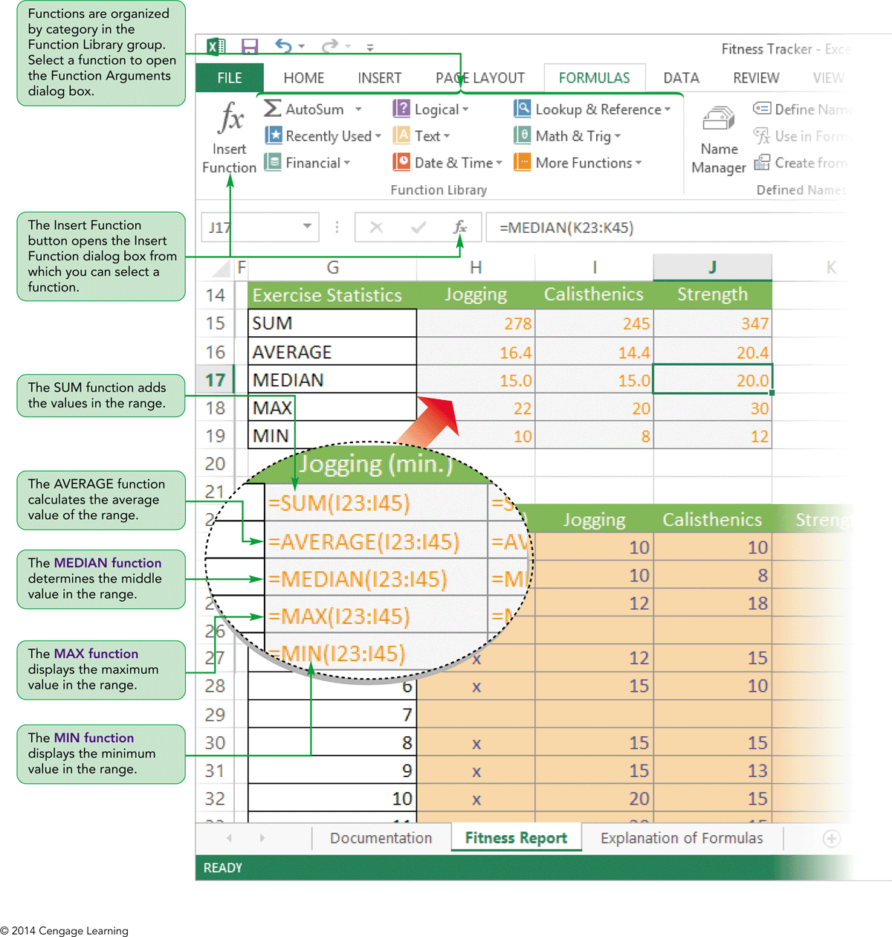
Visual Overview:
Functions and Cell References

Slide 6
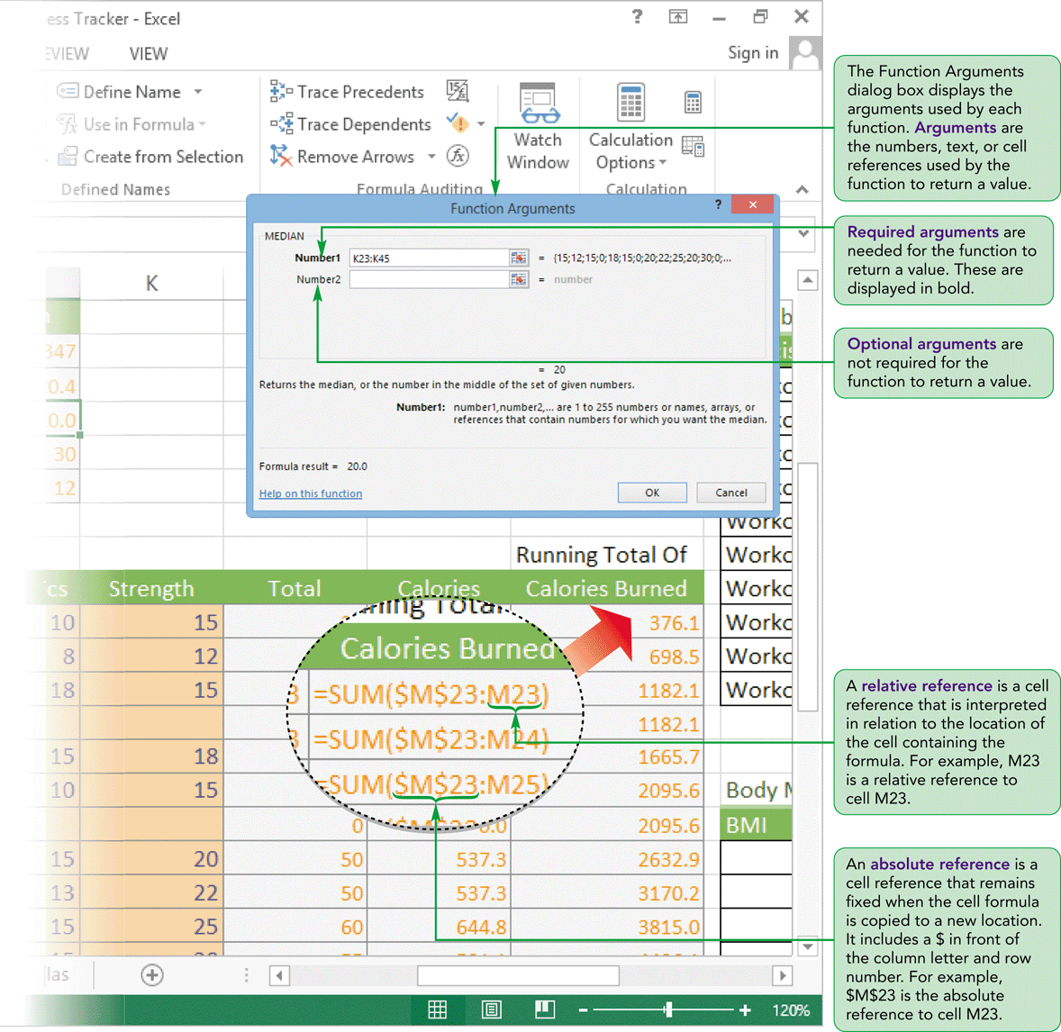
Visual Overview:
Functions and Cell References

Slide 7
Making Workbooks User-Friendly
Many users may use the workbook so it is important they understand the contents
An explanatory worksheet can be added explaining concepts including:
  Industry jargon (industry-specific terms, or technical terms) or unusual terms
  What is being calculated and why
  How the equations make those calculations

Slide 8
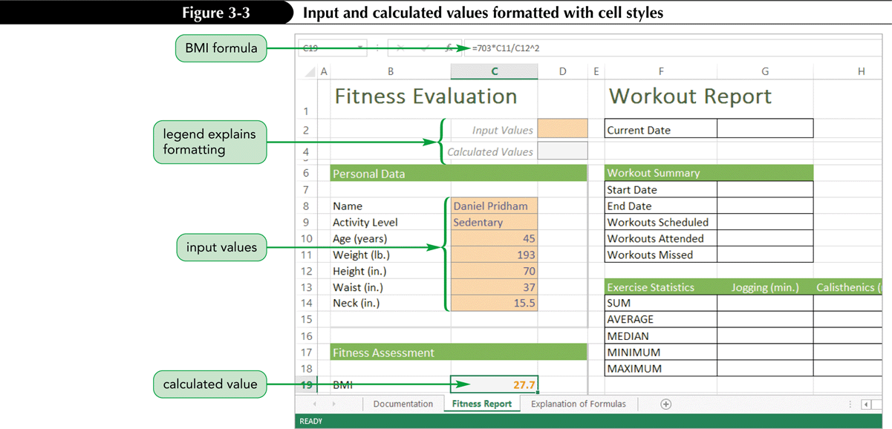
Making Workbooks User-Friendly
Using formatting and styles to differentiate cell contents

Slide 9
Using Excel Functions
Quick way to calculate summary data
Every function follows a set of rules (syntax) that specifies how the function should be written
General syntax of all Excel functions:
Square brackets indicate optional arguments:

Slide 10
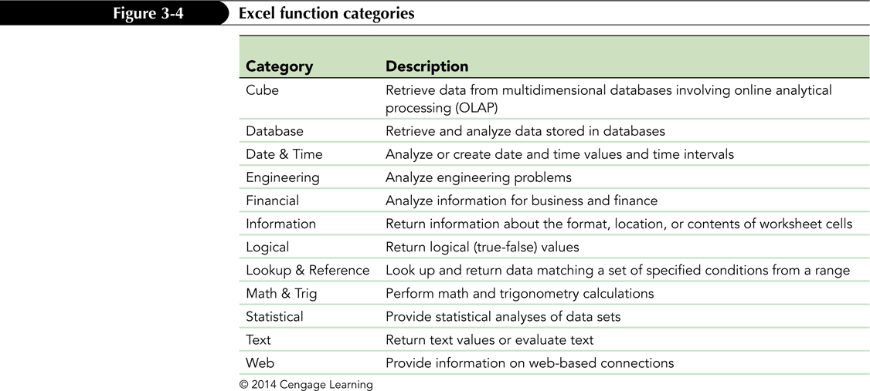
Using Excel Functions
Excel supports an extensive library of functions, organized into 12 categories

Slide 11
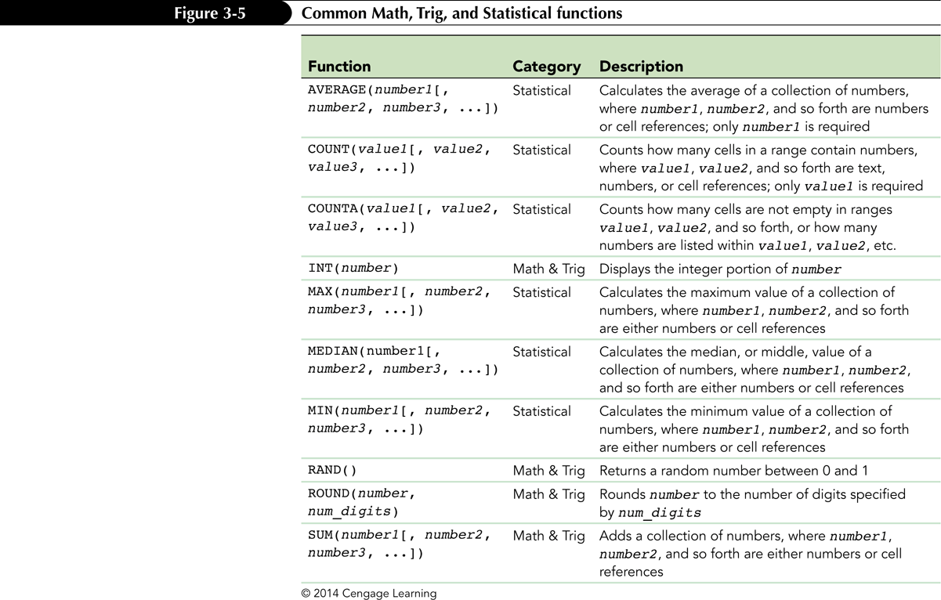
Using Excel Functions

Slide 12
Using Excel Functions
An argument can be any type of value including text, numbers, cell references, or even other formulas or functions
Functions can be placed inside another function, or nested; nested functions must include all parentheses

Slide 13
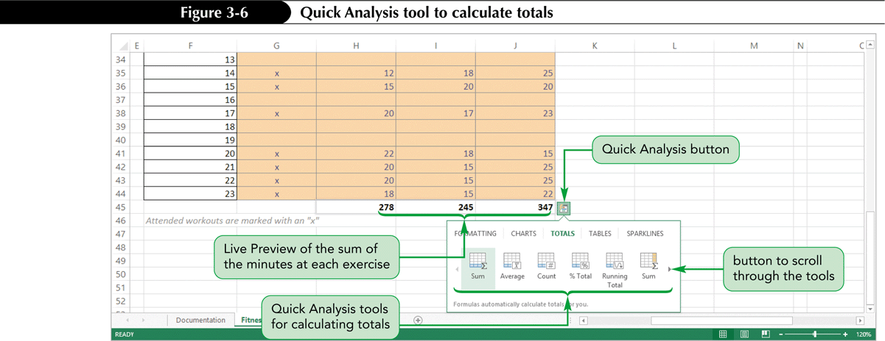
Entering Functions with the
Quick Analysis Tool
The Quick Analysis tool can generate columns and rows of summary statistics that can be used for analyzing data

Slide 14
Entering Functions with the
Insert Function Dialog Box
Functions are organized in the Function Library group on the FORMULAS tab
  You can select a function from a function category
  You can open the Insert Function dialog box to search for a particular function
  When you select a function, the Function Arguments dialog box opens
The median provides the middle value from a data sample

Slide 15
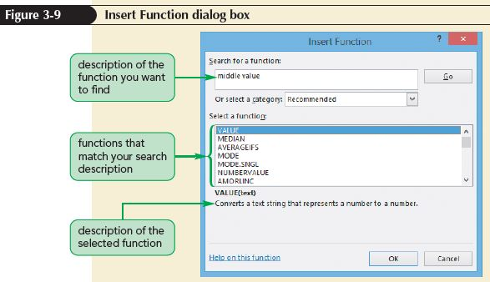
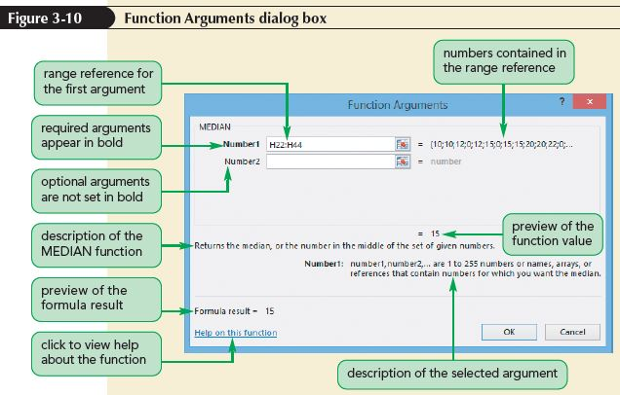
Entering Functions with the
Insert Function Dialog Box

Slide 16
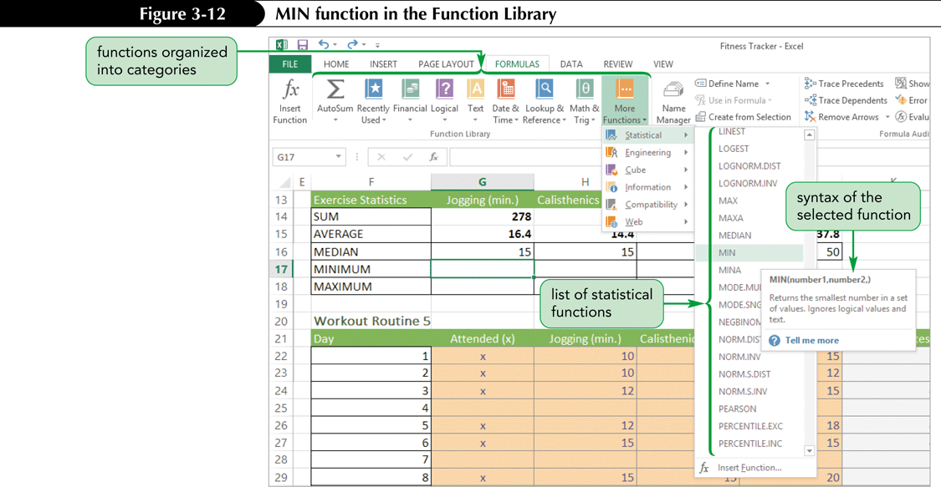
Entering Functions with the
Insert Function Dialog Box
When a function is selected, a ScreenTip appears displaying the function syntax and a description of the function

Slide 17
Interpreting Error Values
An error value indicates that some part of a formula is preventing Excel from returning a calculated value
An error value begins with a pound sign (#) followed by an error name that indicates the type of error

Slide 18
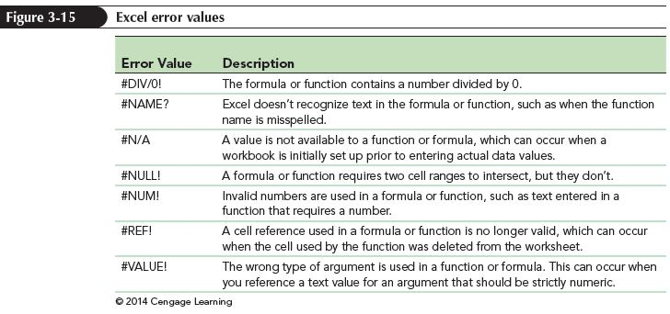
Interpreting Error Values

Slide 19
Exploring Cell References
Workbooks can include data entered in cells that are then referenced in formulas to perform calculations on that data
Types of cell references
  Relative
  Absolute
  Mixed

Slide 20
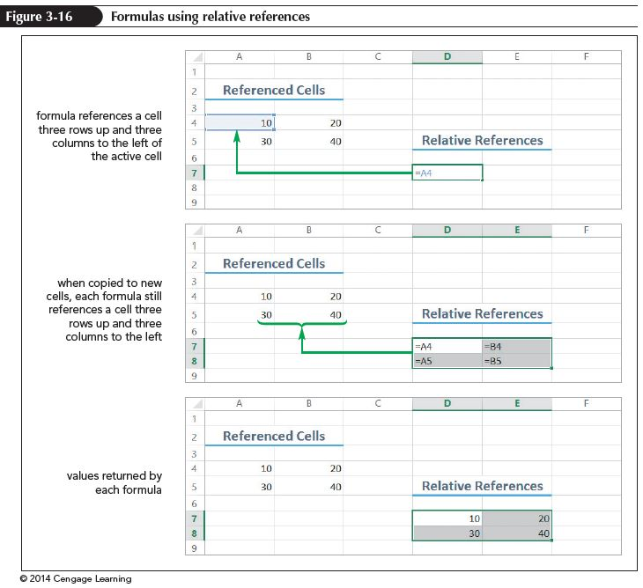
Understanding Relative References
When a formula includes a cell reference, Excel interprets it as being located relative to the position of the current cell

Slide 21
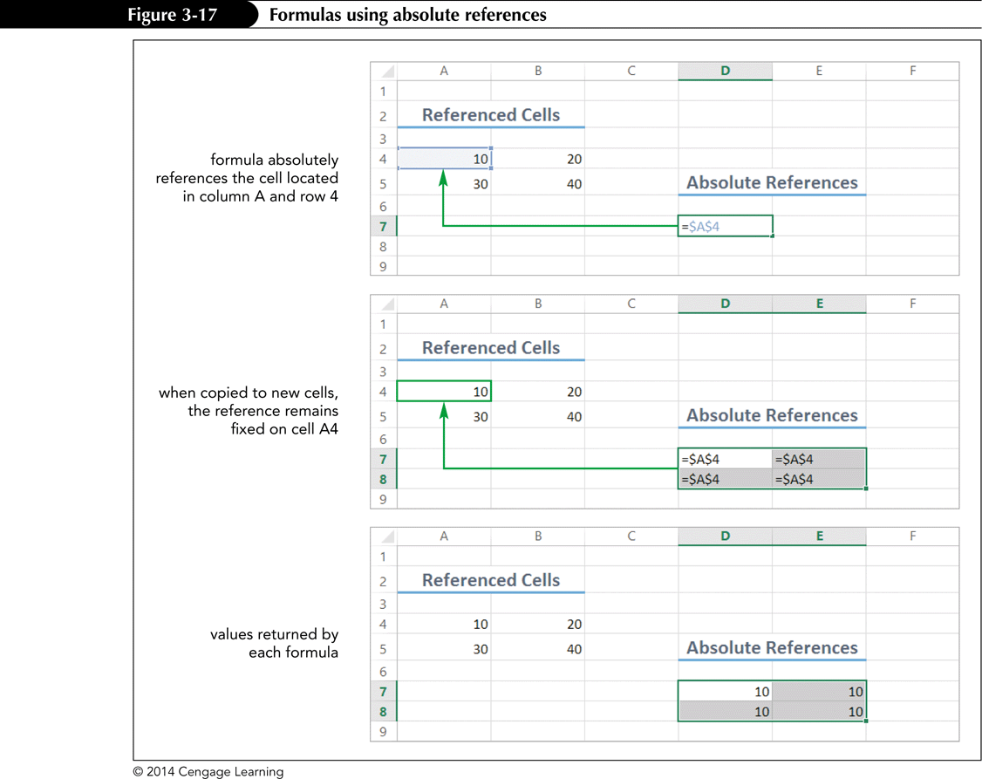
Understanding Absolute References
A fixed reference—one that always references the same cell no matter where it is moved—is called an absolute reference

Slide 22
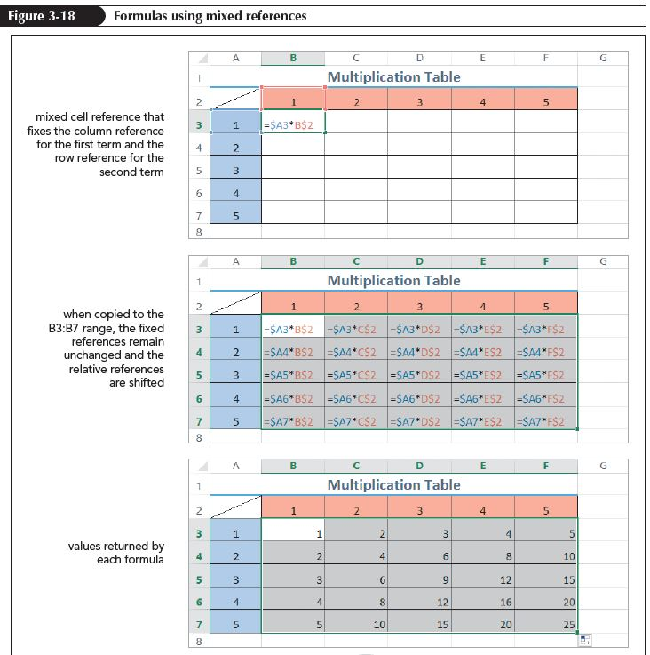
Understanding Mixed References
A mixed reference contains both relative and absolute references

Slide 23
Changing Cell References in a Formula
To quickly switch a cell reference from relative to absolute or mixed
  Select the cell reference in Edit mode
  Press the F4 key
  Excel cycles through the different reference types—starting with the relative reference, followed by the absolute reference, then to a mixed reference with the row absolute, and finally to a mixed reference with the column absolute

Slide 24
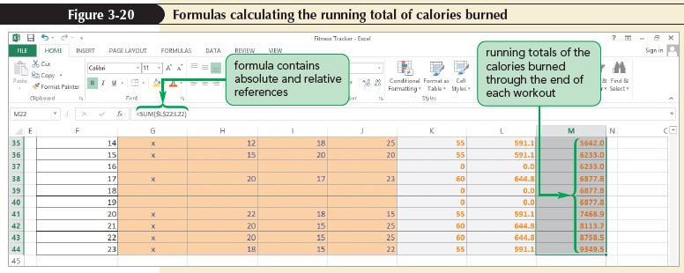
Planning Which Cell Reference to
Use in a Formula
To include the correct type of cell reference in a formula as you create the formula requires more thought up front—consider how each cell in a formula needs to be referenced before you create the formula

Slide 25
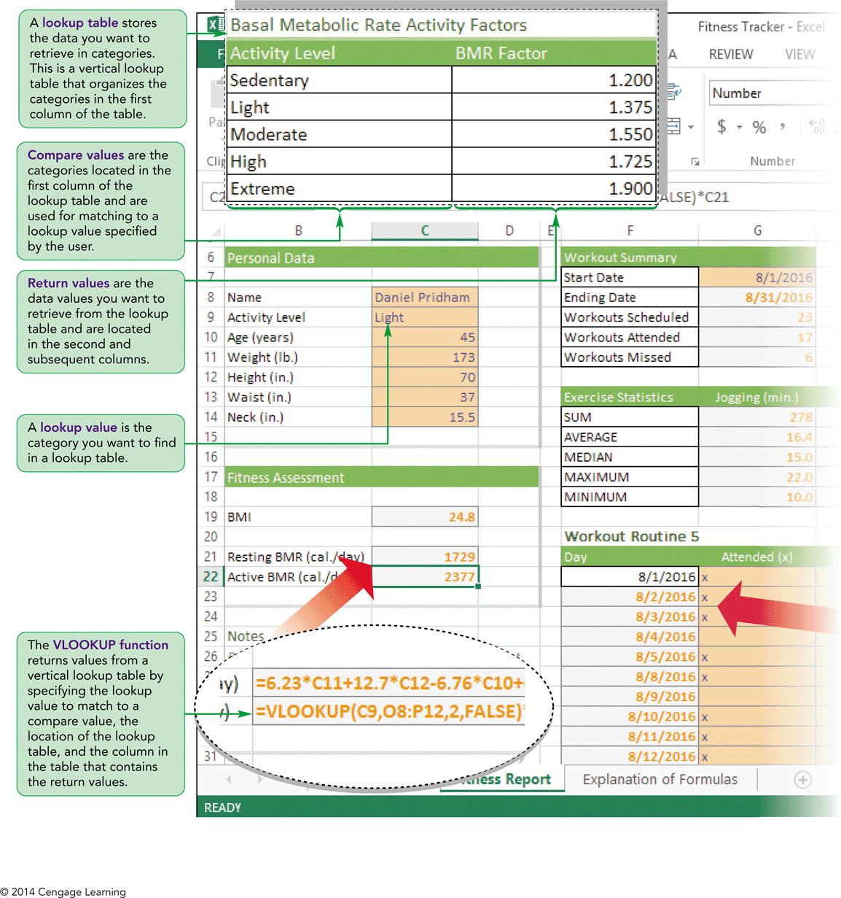
Visual Overview:
Logical and Lookup Functions

Slide 26
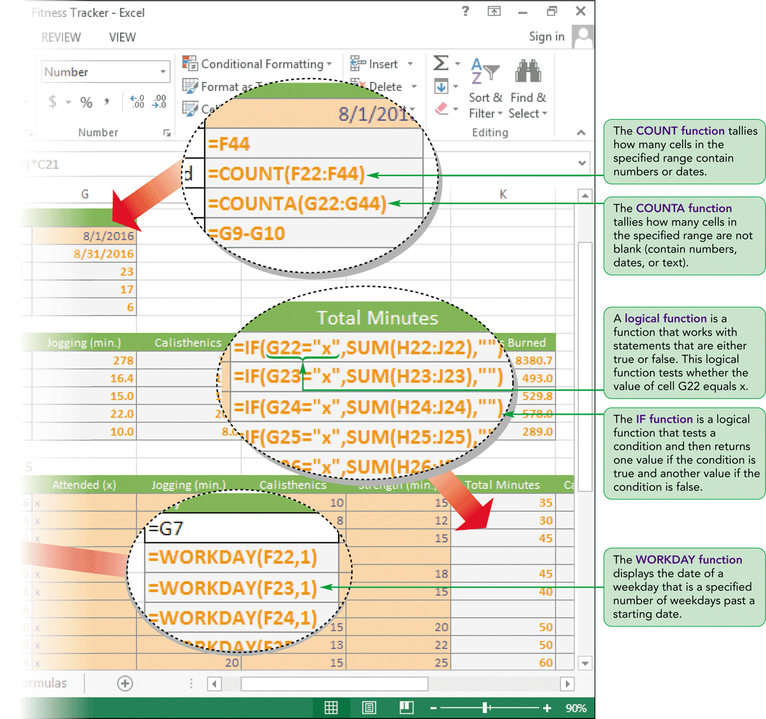
Visual Overview:
Logical and Lookup Functions

Slide 27
AutoFilling Formulas and Data
AutoFill provides a quick way to enter content and formatting in cells based on existing entries in adjacent cells
After you select a range, a fill handle appears in the lower-right corner of the selection
  When you drag the fill handle over an adjacent cell or range, AutoFill copies the content and formats from the original cell or range into the adjacent cell or range
  More efficient than the two-step process of copying and pasting

Slide 28
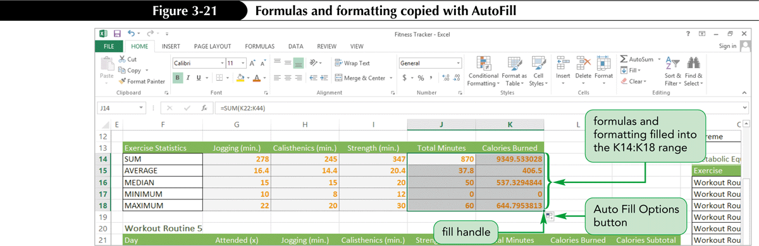
AutoFilling Formulas and Data

Slide 29
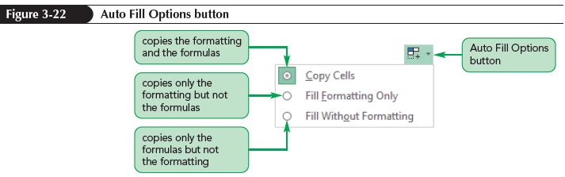
Using the Auto Fill Options Button
By default, AutoFill copies both the content and the formatting of the original range to the selected range
Use Auto Fill Options button to specify what is copied

Slide 30
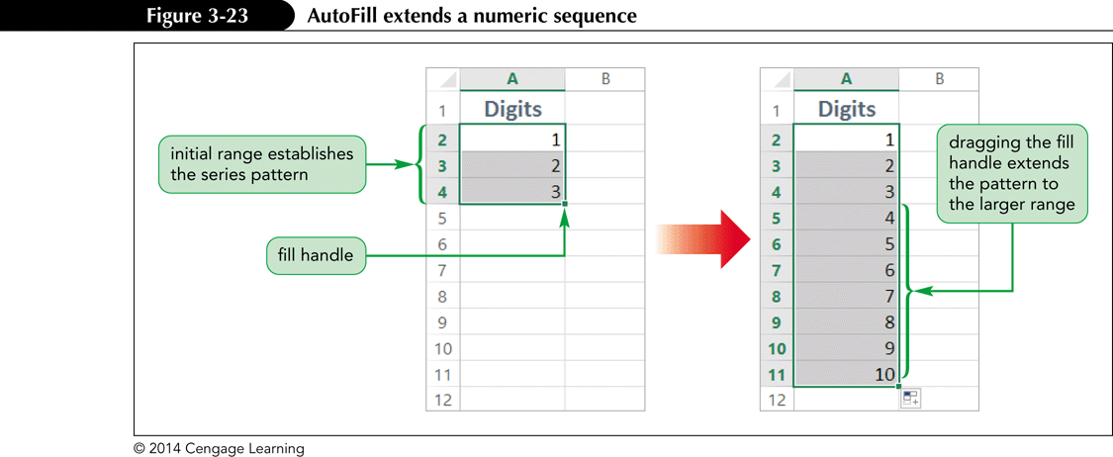
Filling a Series
Use AutoFill to create a series of numbers, dates, or text based on a pattern
Use the Series dialog box for more complex AutoFill patterns

Slide 31
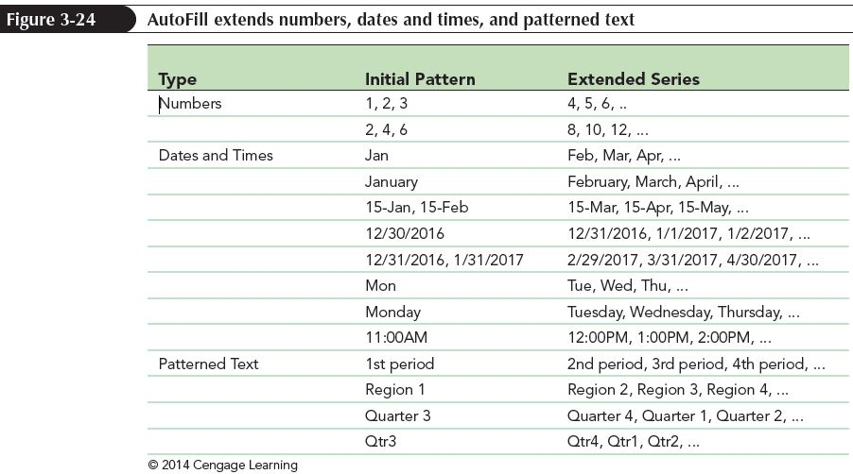
AutoFilling Formulas and Data

Slide 32
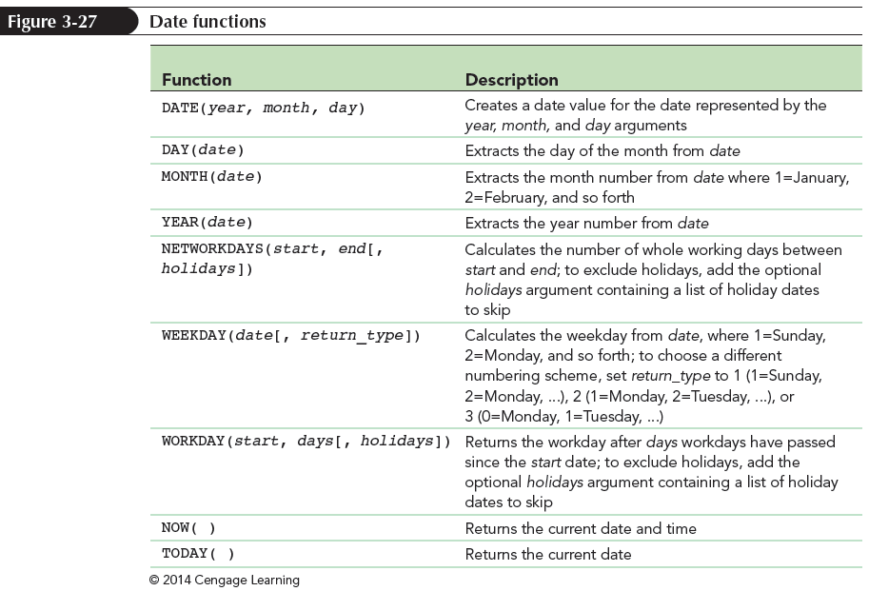
Working with Date Functions
Date functions insert or calculate dates and times

Slide 33
Displaying the Current Date with the TODAY function
Many workbooks include the current date
Use the TODAY function to display the current date in a worksheet
The TODAY function has the following syntax:
=TODAY()
The date displayed by the TODAY function is updated automatically whenever you reopen the workbook or enter a new calculation

Slide 34
Displaying the Current Date with the TODAY function
Inserting the Today function
  Select the cell you wish the date to appear in
  On the FORMULAS tab, in the Function Library group, click the Date & Time button to display the date and time functions.
  Click TODAY; the Function Arguments dialog box opens and indicates that the TODAY function requires no arguments
  Click the OK button; the formula =TODAY() is entered in the selected cell

Slide 35
Finding the Next Weekday with the WORKDAY function
Use the WORKDAY function to fill in the remaining weekdays based on the start date you specify
The WORKDAY function displays the date of the weekday a specific number of weekdays past a starting date
The syntax of the WORKDAY function is
=WORKDAY(start, days[, holiday])

Slide 36
Counting Cells
Excel has two functions for counting cells—the COUNT function and the COUNTA function
COUNT function:
  The COUNT function tallies how many cells in a range contain numbers or dates
  The COUNT function does not count blank cells or cells that contain text
  The COUNT function syntax is
  COUNT(value1[, value2, value3, ...])

Slide 37
Counting Cells
COUNTA function
  Use to tally the nonblank cells in a range—whether those entries are numbers, dates, or text
  The COUNTA function syntax is:
  COUNTA(value1[, value2, value3, ...])

Slide 38
Working with Logical Functions
Logical functions
  Build decision-making capability into a formula
  Work with statements that are either true or false
Excel supports many different logical functions, including the IF function

Slide 39
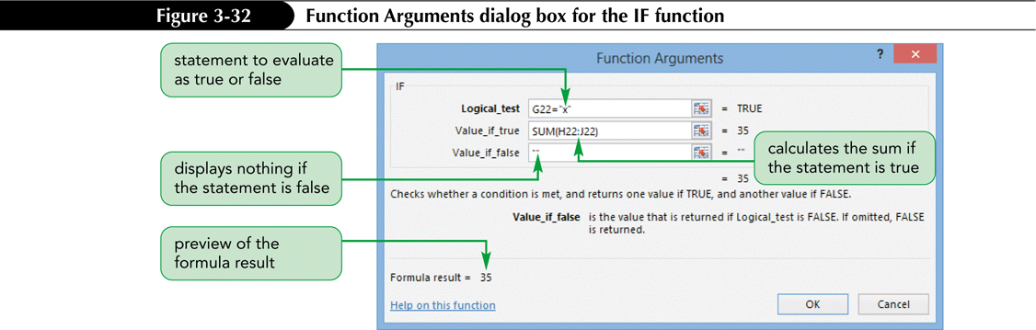
Using the IF Function
Returns one value if a condition is true and returns a different value if that condition is false
The syntax of the IF function is:
(logical_test, [value_if_true,] [value_if_false])

Slide 40
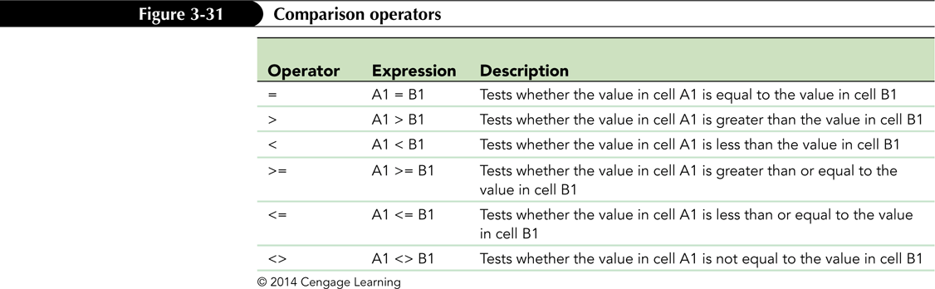
Comparison Operators
A comparison operator is a symbol that indicates the relationship between two values

Slide 41
Using a Lookup Function
Lookup functions find values in tables of data and insert them in another location in the worksheet such as cells or in formulas
  An exact match lookup is when the lookup value must match one of the compare values in the first column of the lookup table
  An approximate match lookup occurs when the lookup value falls within a range of numbers in the first column of the lookup table

Slide 42
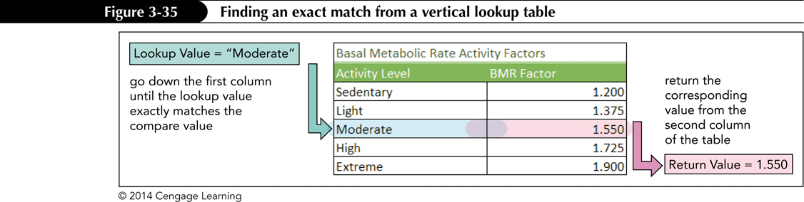
Using a Lookup Function
The table that stores the data you want to retrieve is called a lookup table
A lookup table organizes numbers or text into categories

Slide 43
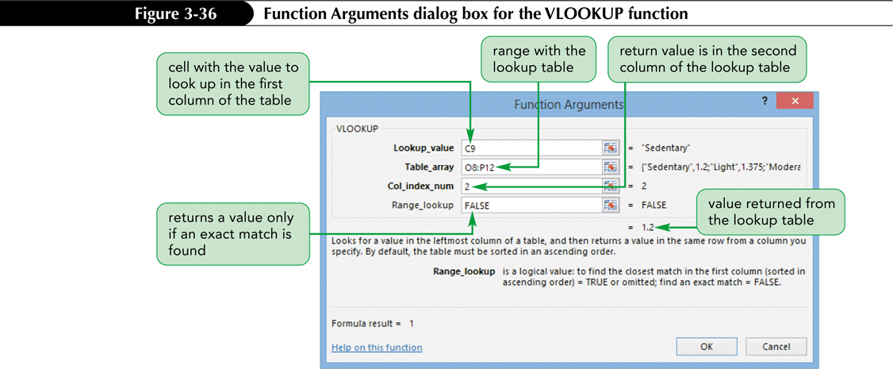
Finding an Exact Match with the VLOOKUP Function
The syntax of the VLOOKUP function is: VLOOKUP(lookup_value, table_array, col_index_num[, range_lookup=TRUE])

Slide 44
Performing What-If Analysis
A what-if analysis lets you explore the impact that changing input values has on the calculated values in the workbook
One way to perform a what-if analysis is by changing one or more of the input values to see how they affect the calculated results

Slide 45
Using Trial and Error
The trial-and-error method requires some guesswork as you estimate which values to change and by how much
To perform a what-if analysis by trial and error:
  Change the value of a worksheet cell (the input cell)
  Observe its impact on one or more calculated cells (the result cells)
  Repeat until the desired results are achieved

Slide 46
Using Goal Seek
Goal Seek automates the trial-and-error process by specifying a value for a calculated item
To perform a what-if analysis using Goal Seek:
  On the DATA tab, in the Data Tools group, click the What-If Analysis button, and then click Goal Seek
  Select the result cell in the Set cell box, and then specify its value (goal) in the To value box
  In the By changing cell box, specify the input cell
  Click the OK button; the value of the input cell changes to set the value of the result cell

Slide 47
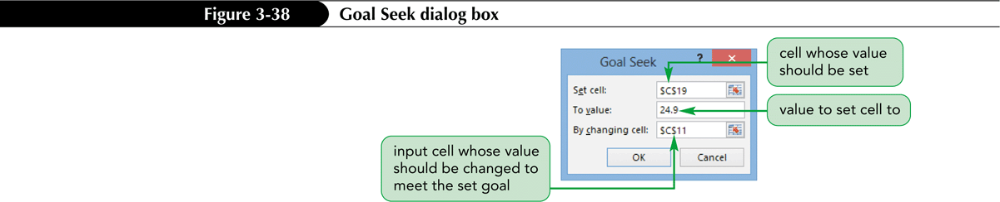
Goal Seek Dialog Box
In some ways, Goal Seek is the opposite of trial and error as it allows you to input the answer and then calculates the associated variables to arrive at the answer

